Slide 1

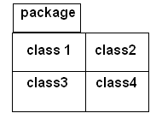
Collection of Java classes is called as a package.
  Package statement:
Packages in Java are declared with the help of package statement.
Package statement must be the first statement in Java Program.
Syntax:
package packagename;

Slide 2

private:
These members are only available inside the same class.
public:
These members are available in any class.
default(friendly access):
These members are only available in the same package.
protected:
These members are available to child classes inside and outside package and also to classes in same package.

Slide 3
Package p1
class abc
class c1
b , c , d
private a
public b
class c2
protected c
default d
b , c , d
Package p2
class c3
class c4
b , c
b

Slide 4
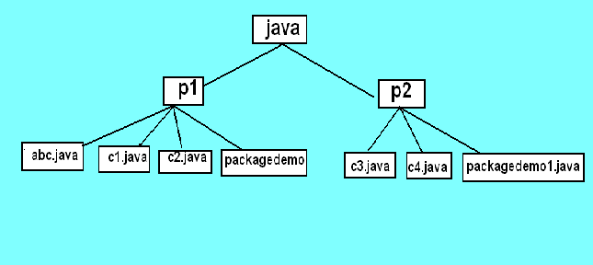

Slide 5

package p1;
public class abc
{
private int a=5;
public int b=10;
protected int c=15;
int d=20;
}

Slide 6
package p1;
public class c1 extends abc
{
public c1()
{
//System.out.println("a="+a);
System.out.println ("b="+b);
System.out.println ("c="+c);
System.out.println ("d="+d);
}
}

Slide 7
package p1;
class c2
{
public c2()
{
abc x=new abc();
//System.out.println("a="+x.a);
System.out.println("b="+x.b);
System.out.println("c="+x.c);
System.out.println("d="+x.d);
}
}

Slide 8
package p1;
class packagedemo
{
public static void main(String[] args)
{
c1 p=new c1();
c2 q=new c2();
}
}

Slide 9
package p2;
import p1.*;
public class c3 extends abc1
{
public c3()
{
//System.out.println("a="+a);
System.out.println("b="+b);
System.out.println("c="+c);
//System.out.println("d="+d);
}
}

Slide 10
package p2;
import p1.*;
class c4
{
public c4()
{
abc1 x=new abc1();
//System.out.println("a="+x.a);
System.out.println("b="+x.b);
//System.out.println("c="+x.c);
//System.out.println("d="+x.d);
}
}

Slide 11
package p2;
class packagedemo1
{
public static void main(String[] args)
{
c3 p=new c3();
c4 q=new c4();
}
}

Slide 12
/*
G:\java>javac p1\abc.java
G:\java>javac p1\c1.java
G:\java>javac p1\c2.java
G:\java>javac p1\packagedemo.java
G:\java>java p1.packagedemo
Child class c1 of abc
b=10
c=15
d=20
Class in same package
b=10
c=15
d=20
*/

Slide 13
/*
G:\java>javac p2\c3.java
G:\java>javac p2\c4.java
G:\java>javac p2\packagedemo1.java
G:\java>java p2.packagedemo1
Child class c1 of abc
b=10
c=15
d=20
Class in same package
b=10
c=15
d=20
*/

